Slide 1
Project introduction:
For my project I have chosen the virtual pet option where I will code the background program for a ‘pet’ like a tamogochi or pokemon where the user can perform basic needs and care for their pet and by doing this keep their pet happy and healthy.
Goals/requirements:
• Hunger
• Happiness
• Energy Player actions e.g. feed, sleep, play
Extensions: Mini-games, Ageing, Random illnesses

Slide 2
The breakdown of my code:
As you enter the game you will be met with a required input for your name and a welcome message, where the game will offer you a free pet egg. In this egg will be one of the 10 possible starter pets : cat, dog, frog, bird, snake, hamster, sheep, chicken, lion or lizard. From there you will be asked to give your pet a name of your choice.
After that you have the option to view your pet's stats, such as hunger, happiness, energy and affection by typing 'stats' . To boost these and keep your pet happy and healthy, you can type (when prompted through a while loop), type 'game' to enter the mini game (created by a def function).
After every input command is completed it will ask you the same question again. If you type 'quit', the game ends and the code stops running.
Every 20 seconds hunger depletes by 2.
Every 30 seconds affection depletes by 2.
Every 35 seconds health depletes by 5.
Every 60 seconds energy depletes by 2.
Overall pet happiness/health is mean/average of all the pets stats and if this reaches any number below 50, your pet unfortunately dies and the game stops.

Slide 3
Code analysis:
On paper.

Slide 4
How would I improve my code?:
I think next time I could have done visuals, maybe more pet types and maybe unique personality traits chosen my user. Also by adding in a random event like illness to the pet and you are taken straight to the mini game (which I would like to make more variations of instead of math equations).

Slide 5
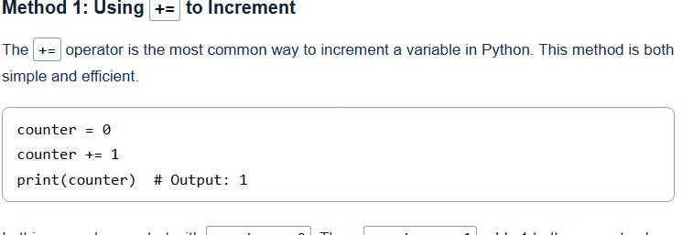
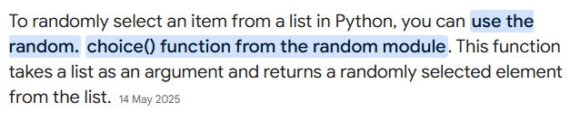
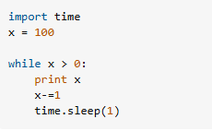
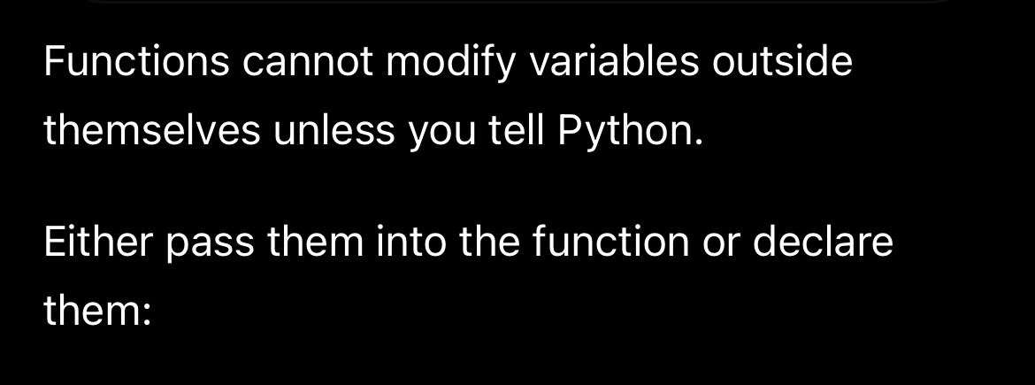
Sites I used for help:

Slide 6
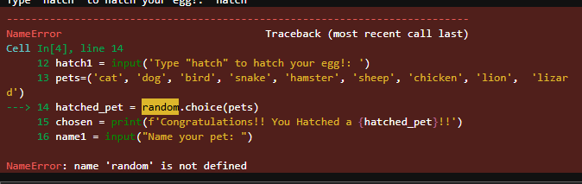
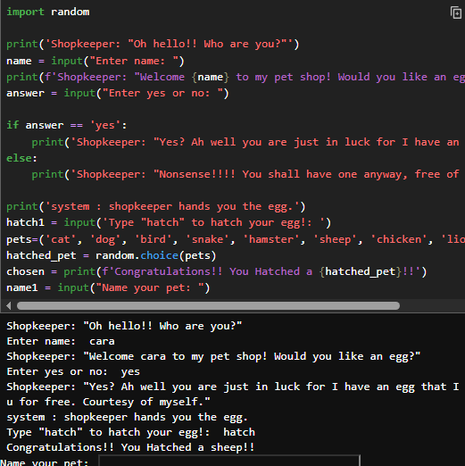
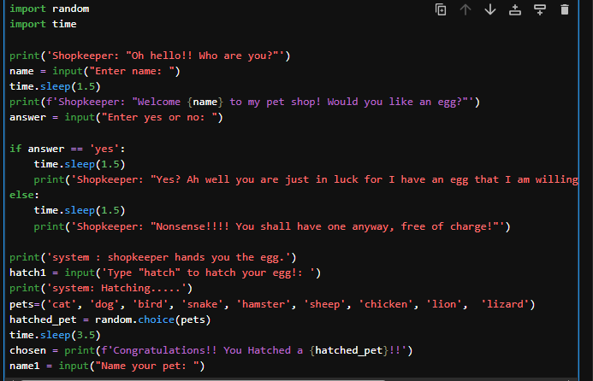
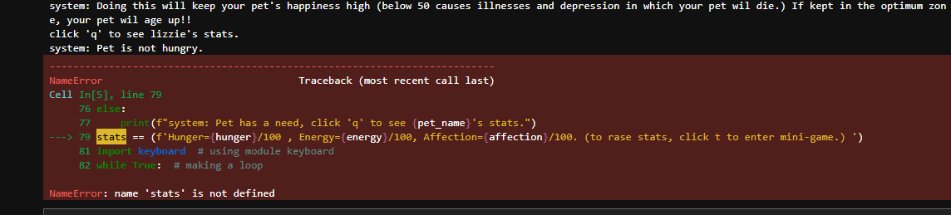
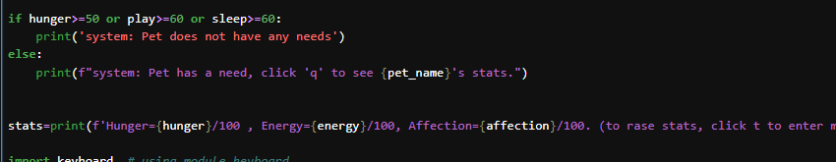
Debugging process:
error | Corrected version | explain
 |  | To use the random module, I had to import it at the start of my code.
Very quick responses (too quick) |  | Added the “import time” and then “time.sleep()” function to make the conversation more realistic.
 |  | My stats variable had a ‘==‘ instead of a ‘=‘ so instead of assigning the value to it, I had done a possiblility.

Slide 7
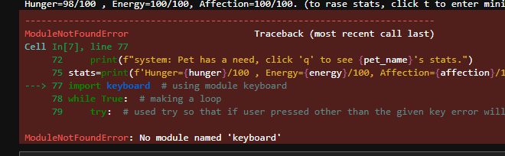
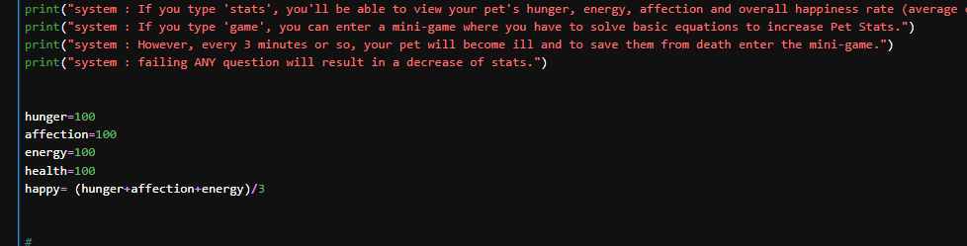
Debugging process:
error | Corrected version | explain
 |  | I discovered that jupyter doesn’t support this type of module so I updated the code to have an input prompt at the end of every action so you can either see pet stats or play a mini-game.
Very quick responses (too quick) |  | Added the “import time” and then “time.sleep()” function to make the conversation more realistic.
 |  | My stats variable had a ‘==‘ instead of a ‘=‘ so instead of assigning the value to it, I had done a possiblility.

Slide 8
Debugging process:
error | Corrected version | explain
The problem was I had defined the mini game after I has asked the computer to run it so nothing happened. (picture 1) |  | So I reordered what I called in first and addded the while loop at the end of my code.
(picture 2) |  | Deleted an if/else statement as it served no purpose.
Count/time was not going as planned and I couldn’t get it to work. | (Picture 3) | Created a loop for the count variable and pet loosing stats.

Slide 9
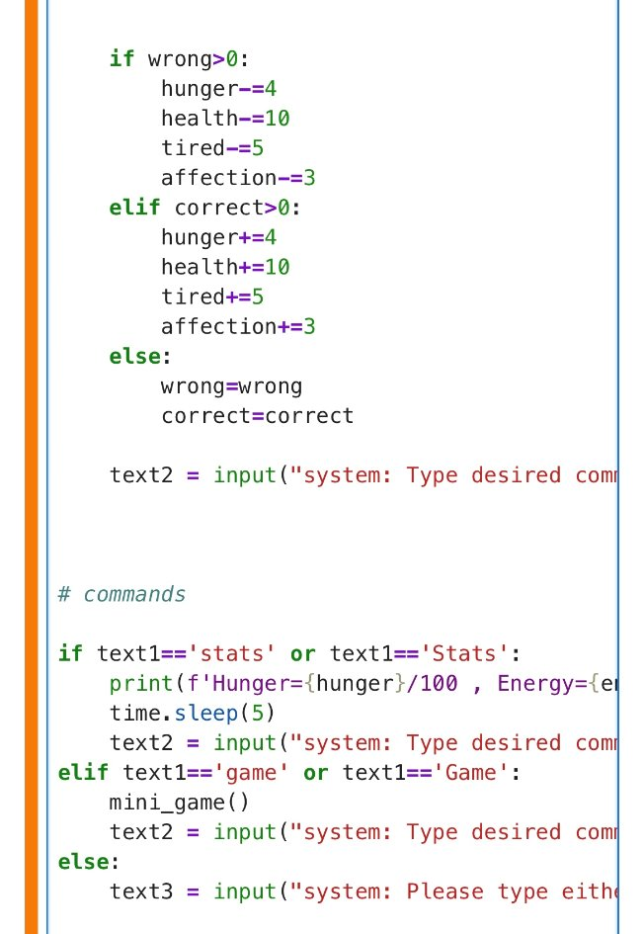
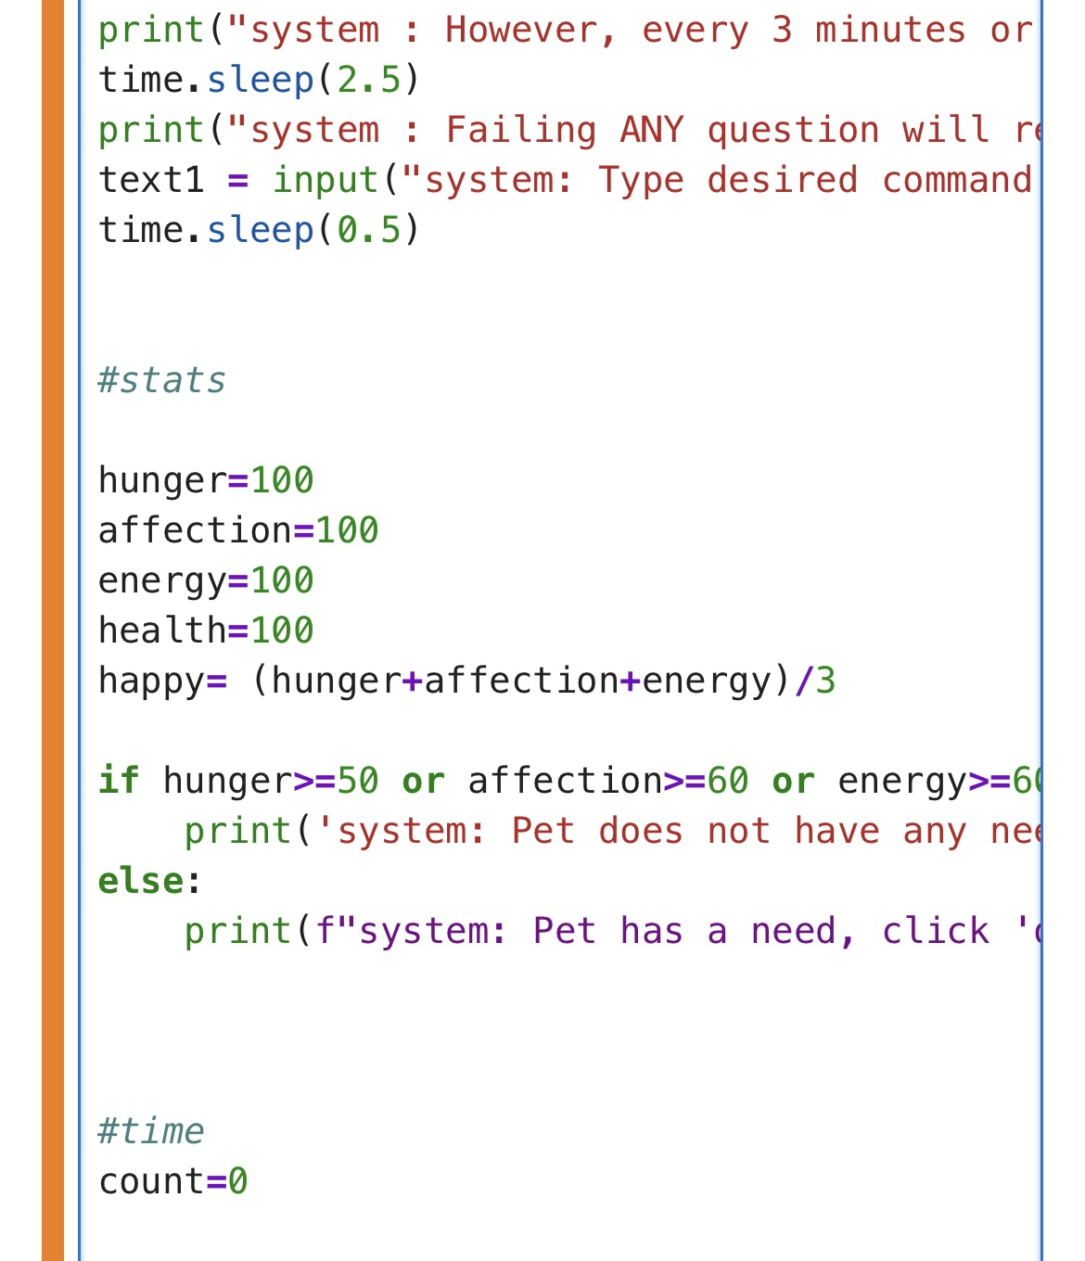
1 2

Slide 10
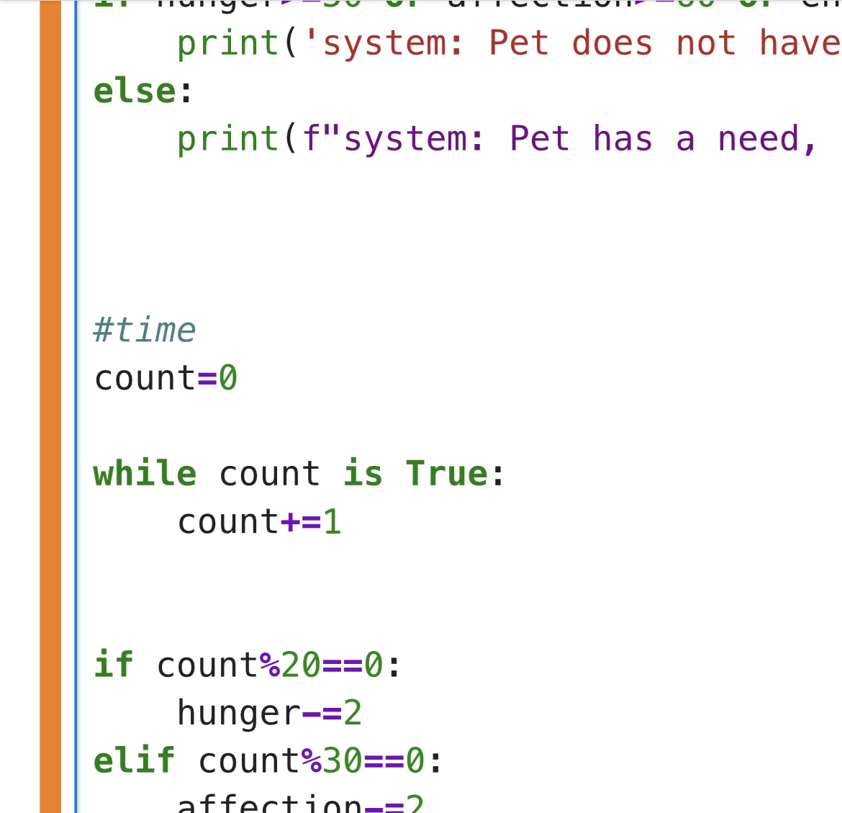
3

